Slide 1
Identifying players in broadcast sports videos
Supervisor: DR. APHRODITE GALATA
Haorui Chen

Slide 2
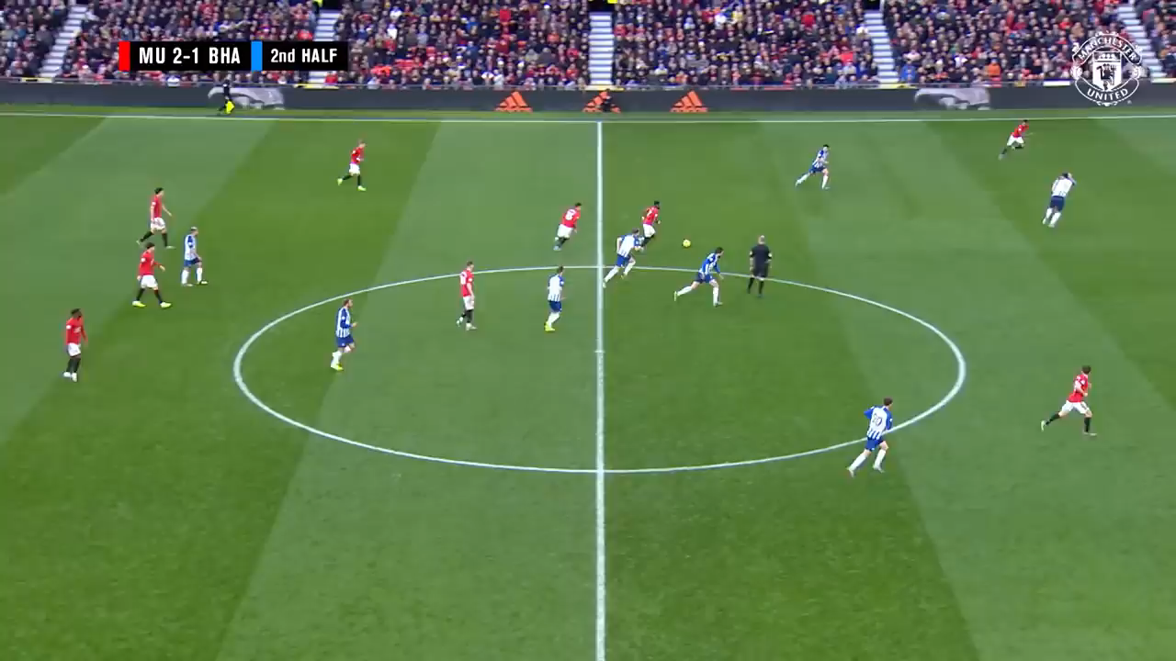

Slide 3


Who scored the goal ?
Who is he ?

Slide 4
Why is it useful?
Looking for possible tactics taken by opponents
Currently: manual review of matches
Ideally: automatic tactic generation
prerequisite
Trajectory & Identity

Slide 5
Project structure
1. player detection
2. player classification
3. tracking
4. label correction

Slide 6
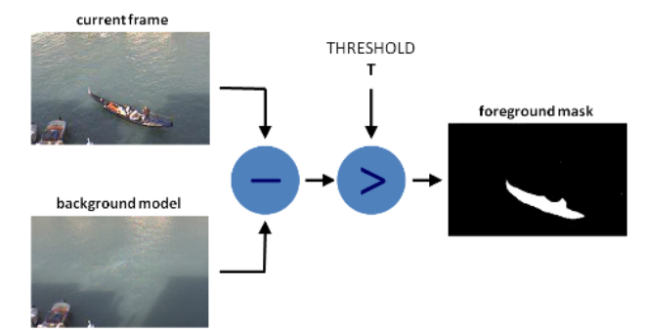
1. player detection
Key point: background subtraction

Slide 7
2. Player classification
Requirement on features: salient local ones using color and image gradient histogram

Slide 8
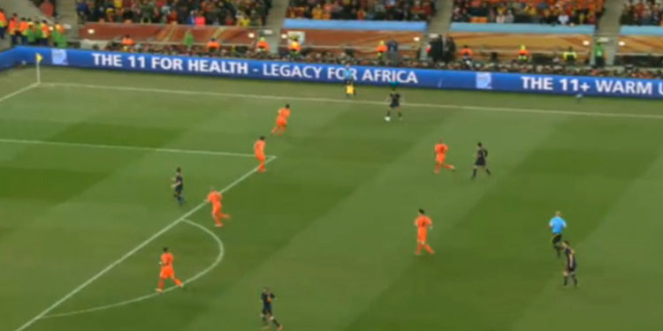
3. Tracking
Key points:
Tracklet
Series of bounding boxes
Tracklet
Tracklet

Slide 9
3. Tracking
Key points:
Tracklet
Kalman Filter
Predicted location
① predict according to historical info
② detect
③ combine info
( weighted average )
Previous location
(in tracklet)

Slide 10
3. Tracking
Key points:
Tracklet
Kalman Filter
Predicted location
① predict according to historical info
② detect
③ combine info
( weighted average )
Detected location

Slide 11
3. Tracking
Key points:
Tracklet
Kalman Filter
Final location
① predict according to historical info
② detect
③ combine info
( weighted average )

Slide 12
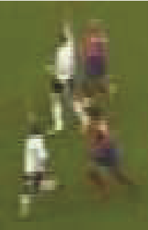
4. Label correction
Key point: inference model
some detections will be misclassiﬁed due to low detail, blurry images and occlusions

Slide 13
deliverables
1. A program
Input: raw video
Output: a video with bounding boxes, that of different player have different label
2. report

Slide 14
My Plan
Sem 1
Week 2-4 background research
Week 5 background subtraction
Week 9 bounding box drawing
Week 10 player classification
Week 11 basic tracking
Week 12 tracking by Kalman filtering

Slide 15
My Plan
CHRISTMAS HOLIDAY
Week 1-2 label correction
Week 3 detection evaluation
SEM 2
Week 1 tracking evaluation
Week 2-3 report
Week 4-8 further improvement

